Slide 2
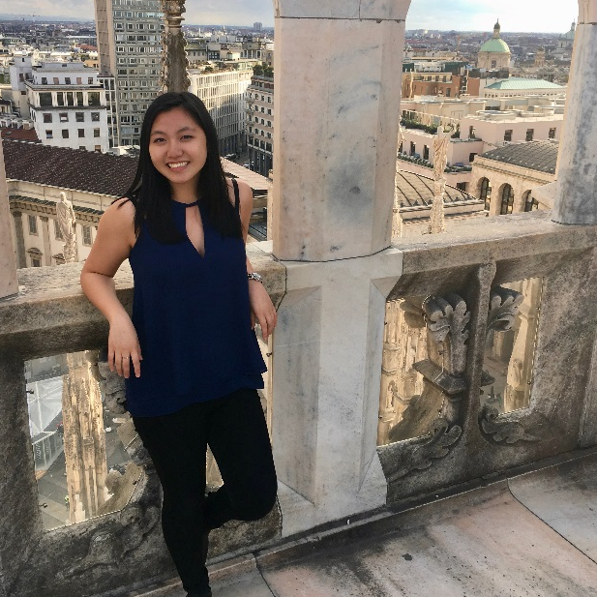
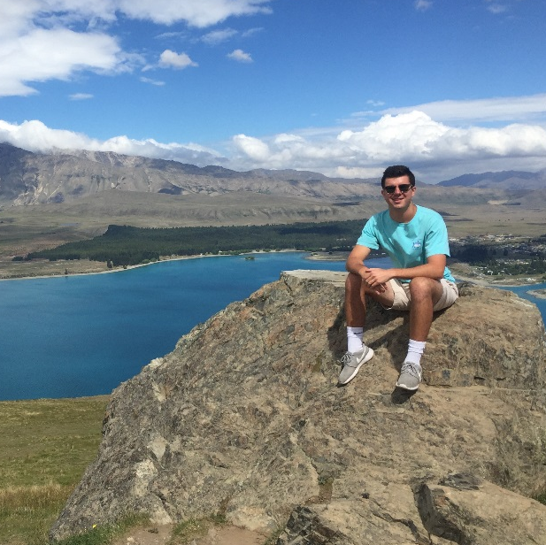
Why Go Abroad?
Career
Advancement
Academic
Growth
Global Experience
Notes:
Career:
Direct impact on skills needed for career success
Internship and research experience, classes in your field of study
Cultural competency, language skills
Academic Growth:
Earn Penn credit on short and long-term programs
Take unique classes, new style of learning
Global Experience:
Be part of the global community, see the world, use skills and knowledge in a global context

Slide 3
What We Offer
Semester Abroad
Earn Penn credit abroad
Use financial aid and scholarships just as you would at Penn
Enhance language skills and cultural competence
Develop lifelong friendships with students from all over the world
Gain soft skills that will translate to career goals post-graduation
Global Research & Internship Program
Research or intern for 8-12 weeks over the summer break
Opportunities on every continent (except Antarctica) and in dozens of career industries
All students receive funding to offset expenses, including flights, housing, or meals
Funding-only application for students who have already found a summer internship or research opportunity
Penn Global Seminars
Intensive semester-long study with an embedded short-term travel component
Course options for students across majors and class years
Flat program fee of $950 that covers all travel expenses including round-trip airfare
Financial aid packages can be applied

Slide 4
Semester Abroad
Establish yourself in a new global community through extended study for a semester or year
Earn Penn credit while you are abroad
Enhance language skills and cultural competence in an immersive, academic environment
Develop lifelong friendships with students from all over the world
Gain soft skills that will translate from study abroad to career goals post-graduation
Use financial aid and scholarships just as you would at Penn
Notes:
Students are billed Penn tuition and the study abroad fee
Costs for housing, dining, books, supplies, transportation, etc. will depend on the location of your program
Penn Abroad provides a budget sheet for every study abroad program that indicates billable and non-billable expenses

Slide 5
Semester Abroad
Abroad!
Complete Penn Abroad application and host university application
(typically in the year prior, but check individual program deadlines)
Think about how going abroad fits in with your academic career
Pre-departure Orientation, getting your visa, preparing to go abroad
Meet with Penn Abroad advisor, academic advisor to talk through options
Receive acceptance to your abroad program and complete any post-decision requirements
Notes:
Talk about when to go abroad, determining your eligibility, and the application process
PASSPORT Application Pieces
Application Essays
Responding to certain abroad scenarios
Destination country knowledge
Study abroad and your identity
Study Abroad Statement of Purpose
Personal, academic, or professional goals for study abroad
External Application for Abroad University
Other Materials
Copy of your passport
Academic Approval Form
Filled out by home school academic advisor for study abroad
Official transcript

Slide 6
Global Research & Internship Program
Enhance your career potential through life-changing global work and research experience
Research or intern for 8-12 weeks over the summer break
Opportunities on every continent (except Antarctica) and in dozens of career industries
All students receive funding to offset expenses, including flights, housing, or meals
Funding-only application for students who have already found a summer internship or research opportunity
Notes:
Every GRIP student will receive funding for their program
50% of the total estimated cost for the summer
Program fee for cohort programs/programs with fee
Additional funding available via the GRIP application
Highly Aided students will receive 100% of the total estimated cost of the summer, funding by Penn Global and SFS

Slide 7
Global Research & Internship Program
Abroad!
Pre-departure Orientation, getting your visa, preparing to go abroad
GRIP placements and application opens in mid-October
Submit your GRIP application by the early January deadline
October – January: Meet with a GRIP advisor for an advising session
Receive decision on GRIP application and funding award in late February
Notes:
Talk about when to go abroad, determining your eligibility, and the application process
PASSPORT Application Pieces
PASSPORT Application Pieces
CV/Resume
Cover Letter/Personal Statement
Additional Funding Questionnaire (optional)
Potential Application Pieces
Supplemental Questions requested by employers
Unofficial transcript
Letter of recommendation
Other
Required advising session with a GRIP advisor
Interview(s) with employer/organizations

Slide 8
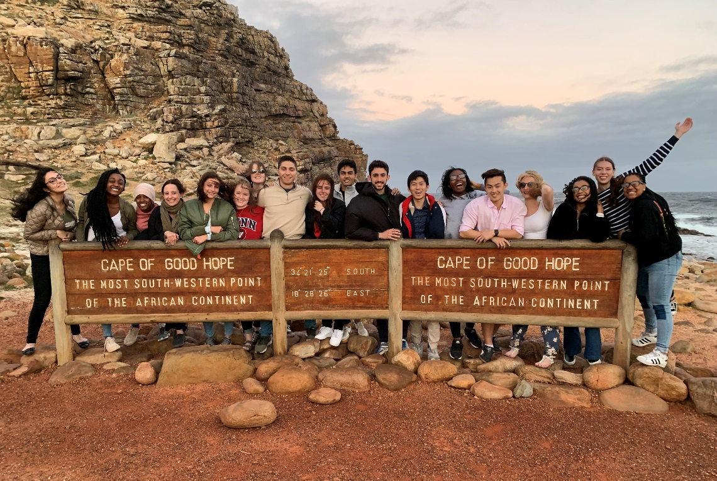
Penn Global Seminars
Deepen your understanding of concepts discussed in the classroom through short-term travel
Intensive semester-long study with an embedded short-term travel component
Course options for students across majors and class years
Flat program fee of $950 that covers all travel expenses including round-trip airfare
Financial aid packages can be applied
Notes:
PGS students will be charged a flat program fee of $950
Covers round-trip airfare, all hotels and accommodations, ground transportation, entrance fees, translation and guide services, and group meals
Eligible for financial aid adjustment
$500 non-refundable deposit at time of commitment and remaining $450 charged at the end of the course add period of the semester

Slide 9
Penn Global Seminars
Applications open the semester prior to the PGS program in accordance with advance registration
Abroad!
Participate in campus portion of seminar course and prepare for short-term travel component
May have an interview with the faculty leading the course
Submit application for PGS course via Penn Abroad PASSPORT portal
Receive decision on acceptance to PGS program (after advance registration closes)
Notes:
Talk about when to go abroad, determining your eligibility, and the application process
PASSPORT Application Pieces
PASSPORT Application Pieces
Personal Statements
PGS and Course of Study
PGS and Past Experience
Supplemental Questions requested by faculty
Unofficial Transcript
Other
Interview with faculty leading the course
Meeting with PGS Manager if needed
Discuss any religious, health, or diet-related accommodations
Must do so prior to committing to the program

Slide 10
Get Connected
Advising & Events
Penn Abroad Ambassadors
Online

